Slide 1

Airbnb Visualization Project
By:
Leila Zintsem
Anna Chee
Dan Waehmer
Peter Sparks

Slide 2
Background

Slide 3

Data Sources
Latitude
Longitude
Neighborhood
Price
Minimum Nights
Room Type
Chicago
New York City
Seattle

Slide 4
Plots

Slide 5
Pin Visualization

Slide 6
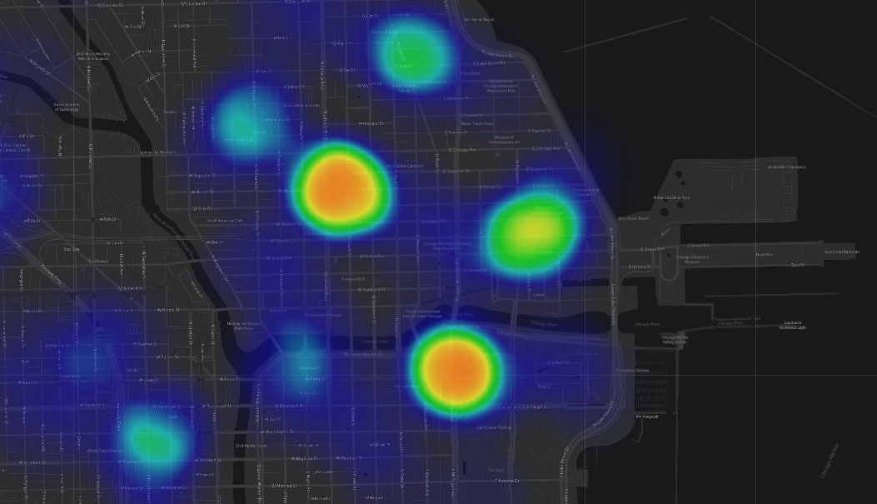

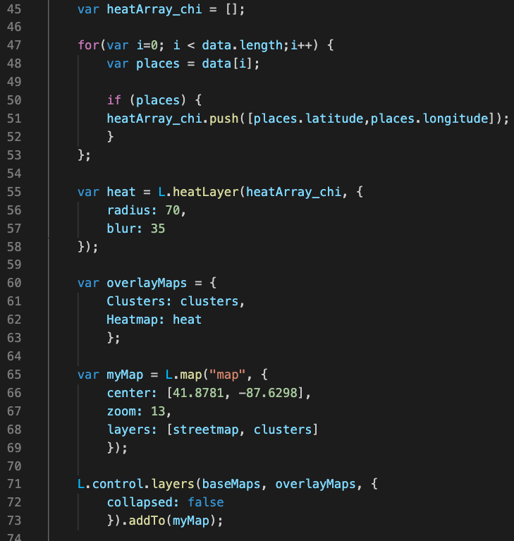
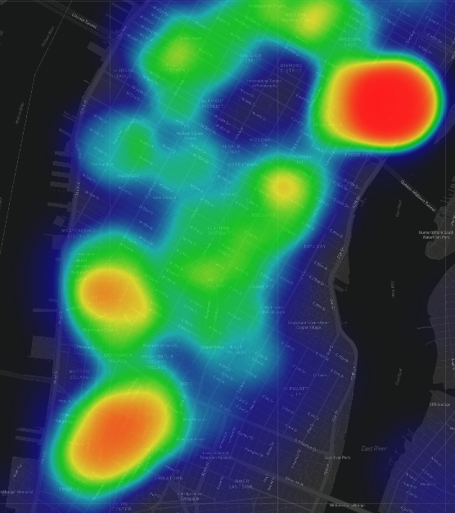
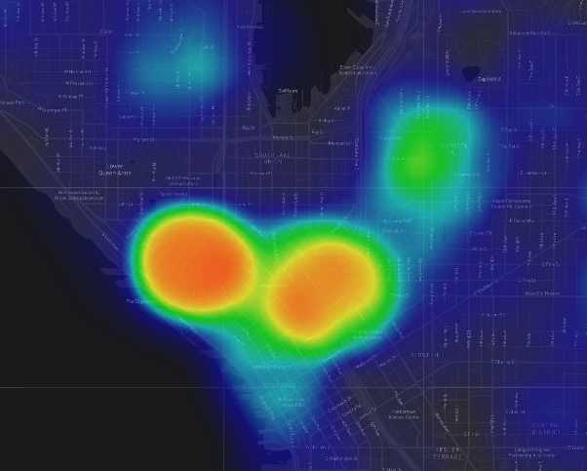
Heatmap Visualization
Helps visualize volume of AirBnB listings by location
CHICAGO
SEATTLE
NEW YORK CITY

Slide 7
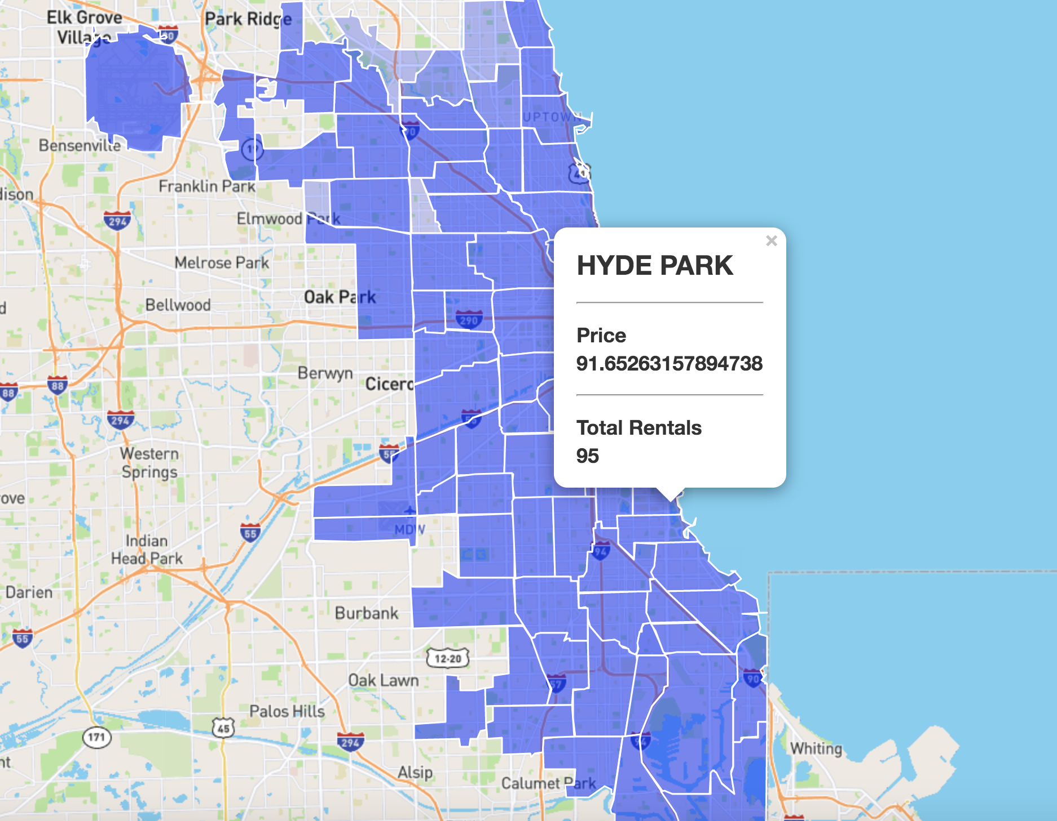
Grid Visualization
Helps visualize price by
neighborhood
Required extra data

Slide 8
LIVE DEMO

